Slide 1
Analysis and Summary of San Antonio 311 – Customer Service
Author: Michael Woods
Date: 3/29/2024

Slide 2
Outline:
Executive Summary
Introduction
Methodology
Results
-Visualizations
-Tableau Dashboard
Findings and Implications
Conclusion
Questions for Further Analysis
Appendix

Slide 3
Executive Summary:
-District with Most Customer Service Cases: District 1
-Category with Most Customer Service Cases : Information
-Department with Most Customer Service Cases: 311
-Sub-Category with Most Customer Service Cases: Cust. Serv.(Complaint)
-Source of Most Customer Service 311 Cases: Constituent Call
-The majority of SLA dates are NOT made by their deadline.
-Can the new Integrated Community Safety Office (ICSO) help in finding answers to data questions and assist in inter-department communication to find lasting answers?

Slide 4
Introduction:
The analysis of this dataset provides a comprehensive summary of 311 cases directed to Customer Service, including information on districts, categories, sub-categories, source reporting methods, cases statuses and SLA dates. It also offers insights into the reasons behind constituents' use of 311. Additionally, this dataset provides a glimpse into the response time of Customer Service to constituents' queries.

Slide 5
Methodology:
The entire dataset was downloaded as a .csv file, accompanied by a spreadsheet that details its contents. The spreadsheet underwent reformatting to enhance its informativeness and readability. Additionally, spelling errors were rectified, dead hyperlinks were replaced with active ones, and further details were incorporated into the comments section.
The initial analysis of the 311 dataset in .csv format was loaded into a Pandas dataframe, akin to Excel, using the Python programming language within a JupyterLab Notebook. The coordinate system present in the dataset was converted from NAD(1986) to latitude and longitude coordinates for utilization in the Tableau visualization software. Various data cleaning methods were applied and tested before generating a new .csv file, which was subsequently exported to Tableau.
The data was then manipulated into a Tableau Dashboard that summarizes the data and filters on any of the filters in the legend such as District, Source etc. . .
Additionally, various calculations and charts were programmed using Python in JupyterLab and the Tableau Dashboard.

Slide 6
Results:
The districts that use 311 Customer Service the most, in order are 1, 3, 5, 2, 4, 7, 6, 10, 9, 8, 0.
The Only Departments for Customer Service 311 use in order are 311, Solid Waste Management, Public Works, Animal Care Services and Parks & Recreation.
The Only Categories for Customer Service 311 use are Information and Dockless Vehicles.
When using Customer Service 311 constituents use "Constituent Call" 73.4% of the time, "Code Proactive Calls" 0.0% and the "311 Mobile App" 26.6%.
The majority of Customer Service Cases do NOT meet the deadlines outlined in their respective Service Level Agreement(SLA) dates(63.0%) even though the Cases are Closed at a rate of 76.2%.

Slide 7
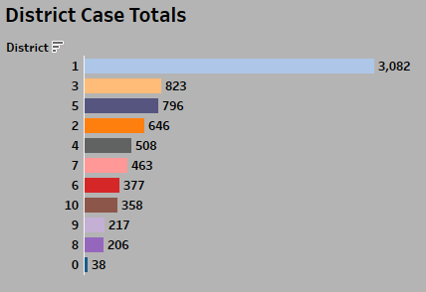
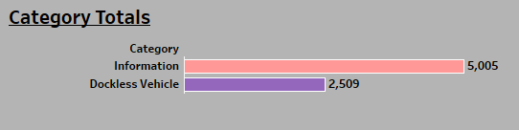
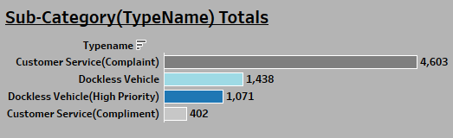
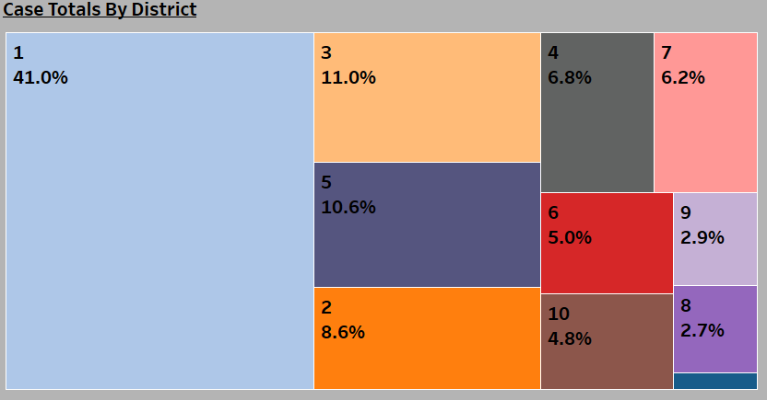
District Case Totals | Category Totals
| Sub-Category(TypeName) Totals

Slide 8
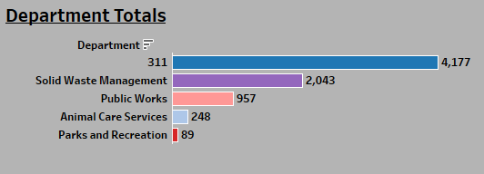
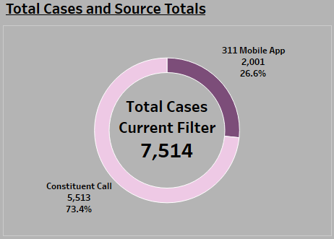
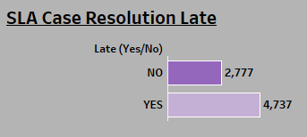
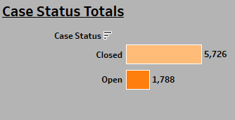
Department Totals
Source Totals
SLA Case Resolution​​
Case Status Totals

Slide 9
Findings and Implications
Findings:
1. The 311 Mobile App was extensively utilized to report dockless vehicle cases, with nearly 80% of all such cases being reported via the app.
2. Dockless vehicle cases exhibit a notably higher closure rate (97%) compared to other Customer Service categories. In contrast, cases related to Information have a lower closure rate of 66%.
3. While Customer Service shows a high rate of case closure, it often fails to meet SLA due dates.
4. District 1 demonstrates significantly higher utilization of Customer Service, accounting for 41% of all cases.
5. Customer Service inquiries related to Information are solely accessed via 'Constituent Call', with no utilization through the 311 Mobile App.
6. The dataset also includes dates dating back to 2019(2017 in the entire 311 dataset), with the average closure time for a Customer Service case being 355 days. Specifically, dockless vehicle case closure averages 669 days.
These findings highlight the predominant use of the 311 Mobile App for dockless vehicle reports, variations in closure rates across different service categories, challenges in meeting SLA deadlines, and the disparity in Customer Service utilization among districts.
Implications:
1. Understanding constituents' preference for reporting dockless vehicles through the 311 Mobile App can provide insights into the app's user experience and effectiveness compared to other reporting methods.
2. Investigating why dockless vehicle cases are closed at a high rate but after their SLA due dates may reveal underlying inefficiencies or challenges in meeting service level agreement requirements.
3. Exploring why cases are closed at a high rate just after their SLA due dates can uncover factors influencing case management practices or SLA enforcement procedures.
4. Understanding the reasons behind the higher utilization of Customer Service in District 1, such as tourism or specific community needs, can inform targeted service improvement strategies and resource allocation decisions.
5. Investigating the availability of an information option on the 311 Mobile App and exploring the feasibility of adding a chatbot specifically for Customer Service inquiries could potentially enhance user experience, optimize resource utilization, and reduce costs within the city's customer service operations.
6. The data also suggests possible issues with the software backend and database infrastructure, as evidenced by reporting dates going back to 2019(2017 for entire dataset). Additionally, the average case closure time is exceptionally long, particularly on dockless vehicles, despite a high rate of case closure.

Slide 10
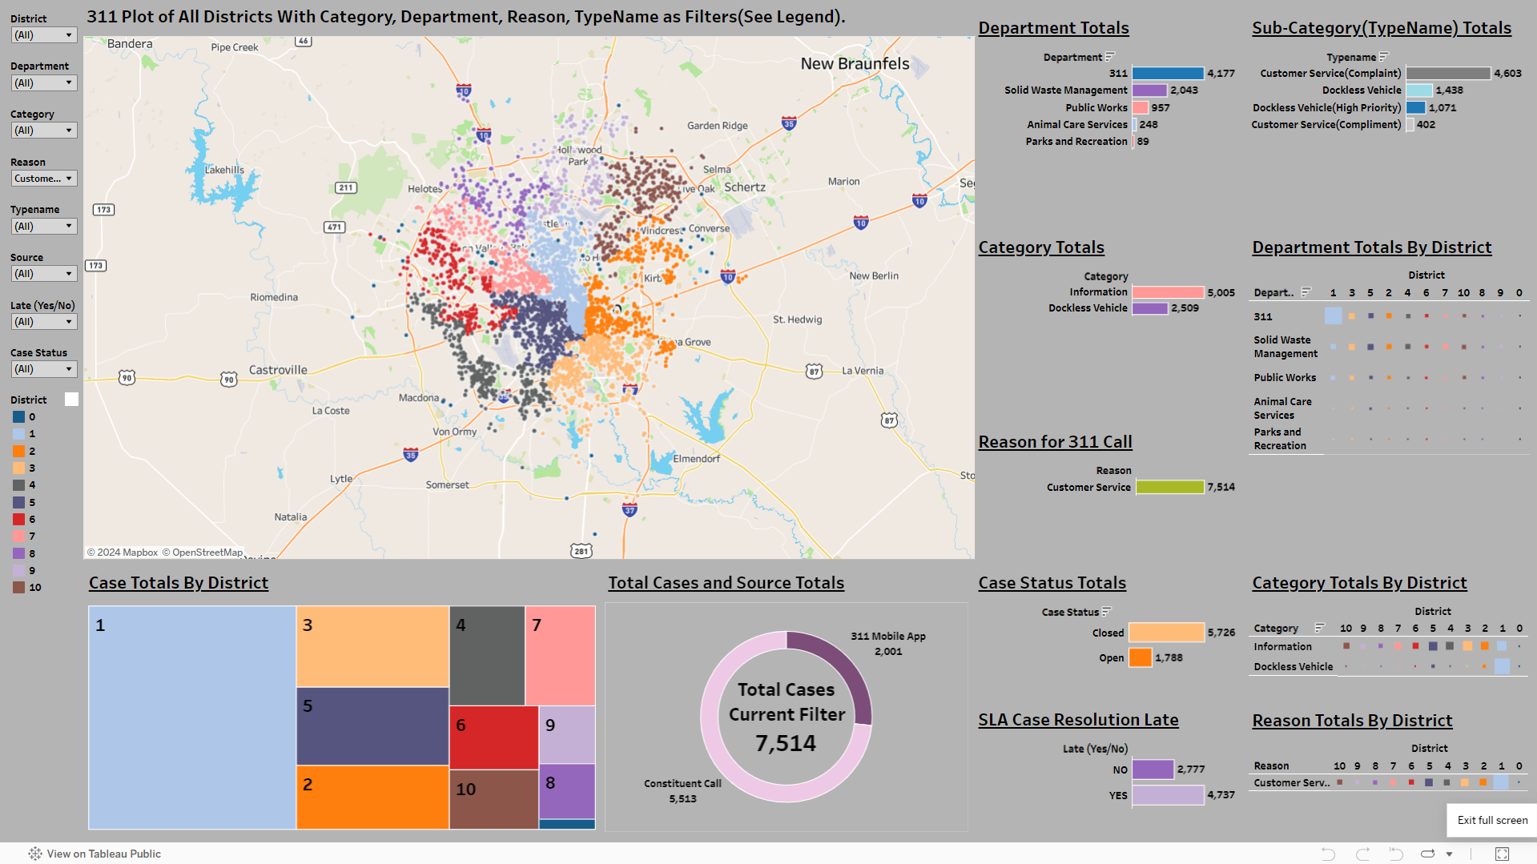
Snapshot of Interactive Tableau Dashboard
See the next slide for details on accessing and using the Interactive dashboard.

Slide 11
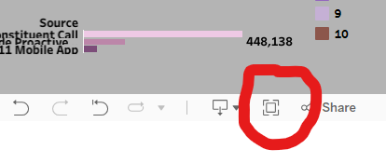
A Couple Notes About The Dashboard
-This dashboard is filtered on the entire 311 dataset, 600,000+ Rows and can be filter on any of the filters on the side. This also means that the dashboard can quickly be filtered for another department, director or used to compare and analyze data from those other departments.
-(If not already filtered) For the Customer Service Dashboard go to the filters and select 'Reason' and then select 'Customer Service' in the drop down menu.
-Make sure to put the dashboard in full screen mode
-To do this, Click on the icon that is circled in red below. The icon is located at the bottom right hand corner of the screen.
-The dashboard will also filter on any individual or combination of filters in the legend. This will filter the entire dashboard via the user specifications.
-The Geo-Spatial map is also interactive.
Link To The Tableau Dashboard

Slide 12
Conclusion
Usage Patterns:
District 1 exhibits the highest utilization of Customer Service, potentially due to tourism. Constituent Calls and the 311 Mobile App are the primary channels, with most dockless vehicle reports submitted via the app.
Case Resolution:
While dockless vehicle cases are reported and closed, many cases fail to meet SLA deadlines. This indicates potential inefficiencies in case management despite a high closure rate.
Potential Improvements:
Implementing features like an Information option on the 311 Mobile App or a chatbot for Customer Service inquiries could streamline processes and reduce costs.
Interdepartmental Collaboration:
The Integrated Community Safety Office (ICSO) could enhance data sharing and communication between departments, facilitating informed decision-making and sustainable solutions.
Overall, optimizing service delivery and fostering interdepartmental collaboration are crucial for improving efficiency and responsiveness in governance.

Slide 13
Questions for Further Analysis:
Why are there much higher cases of Customer Service use in D1?
What departments & districts get the most customer service complaints and compliments?
Why are there cases from 2017 in the dataset?
How does the City of San Antonio compare to other major metropolitan areas on Constituents use of 311?
Why are dockless vehicles not meeting SLA Resolution Dates?
Why is the average resolution time for customer service 355 days compared to 24 days of average resolution time for whole the dataset(600,000+ cases)?
Juxtapose other datasets against the 311 dataset to find more substantial correlations and causations.

Slide 14
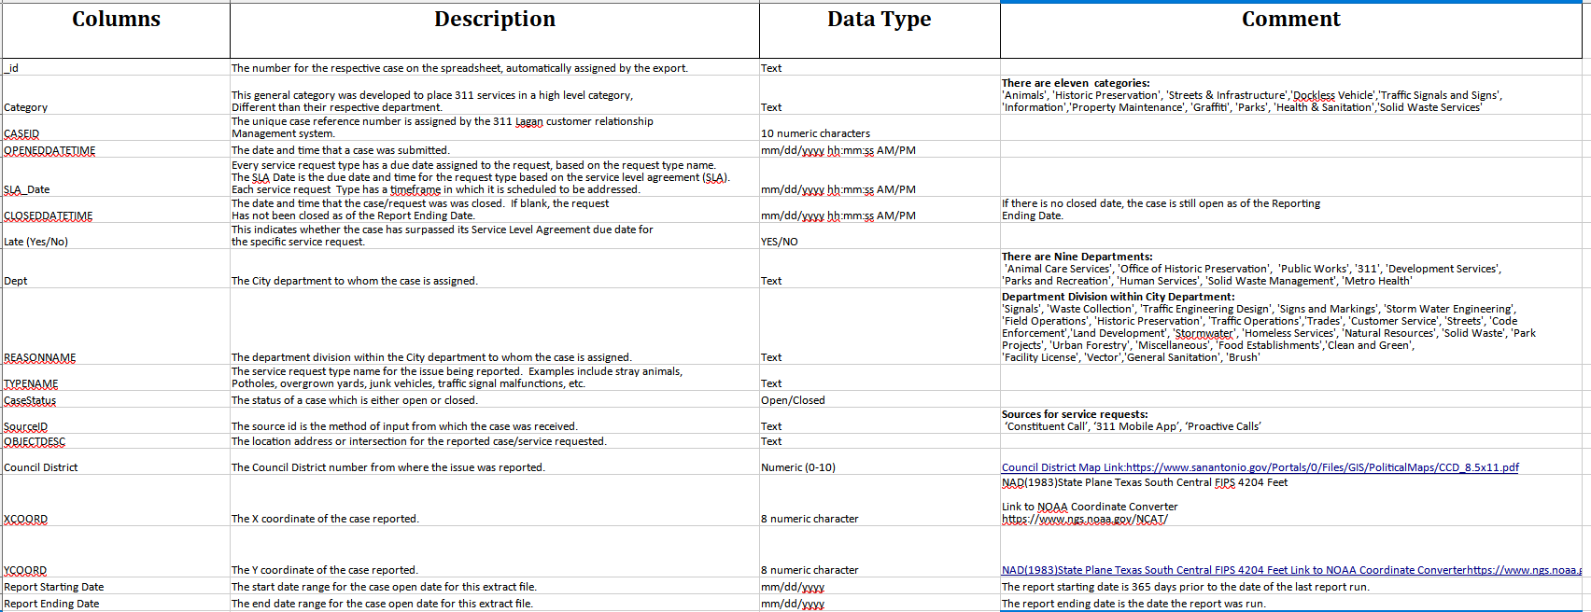
Appendix:
Github Links to Jupyter Notebooks:
Jupyter_NoteBook_1
Jupyter_Notebook_2

Slide 15
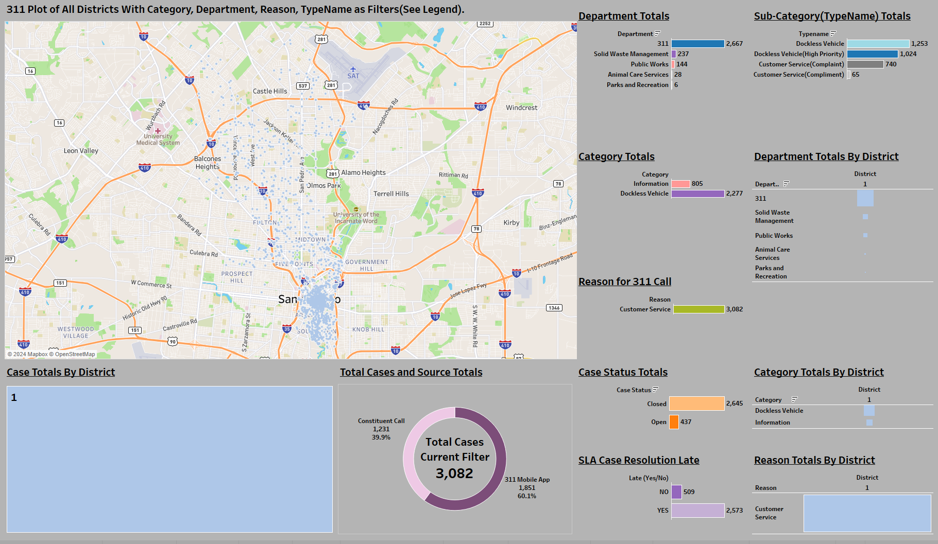
D1 – Summary-Analysis

Slide 16
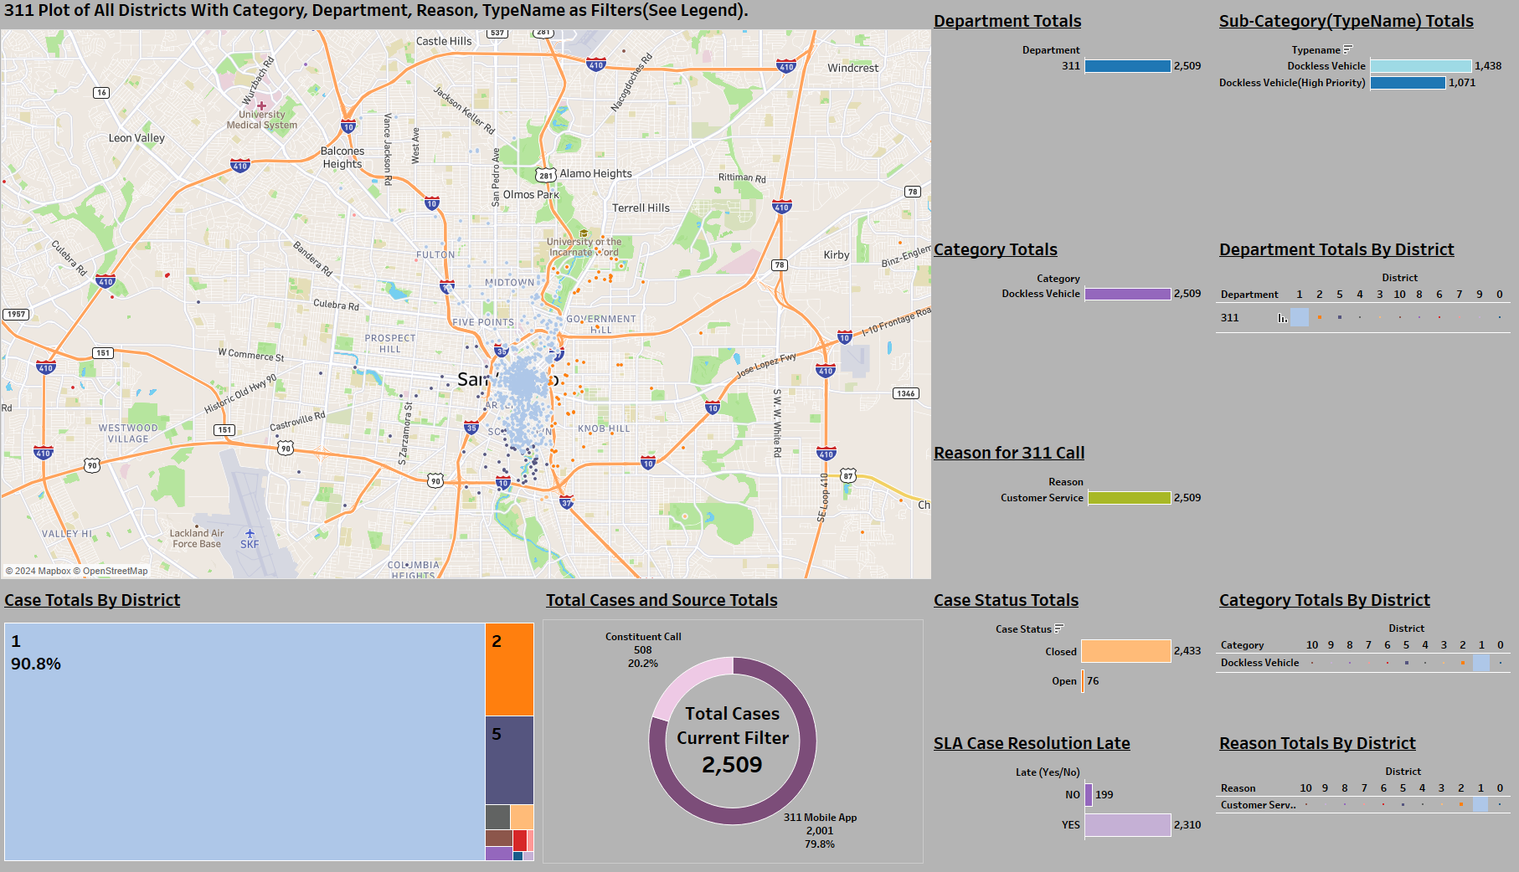

Slide 17
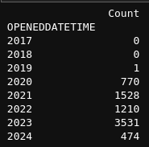
Juxtapose Other Datasets against 311 for Further Analysis | Customer Service—Department Stats-Dates:
SAPD Bike Patrol Districts
SAPD SAFFE Zones
SAFD Areas
Solid Waste Management:
Closed Cases(98.9%) and SLA dates are met by(95.3%).
Public Works:
Closed Cases(93.3%) and SLA dates are NOT met by(63.9%)
Animal Care Services:
Closed Cases(31.0%) and SLA dates are NOT met by(87.1%)
-LOTS OF OPEN CASES
Parks and Recreation:
Cases closed(100.0%) and SLA dates are met by(79.8%)

Slide 18
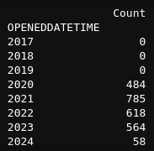
Dockless Vehicle Count by Customer Service and Year

